Slide 1
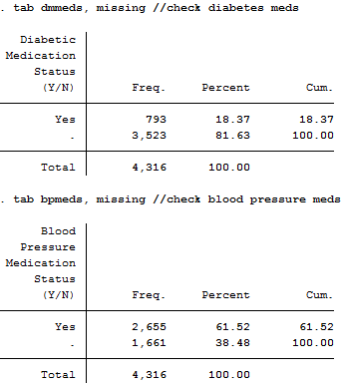
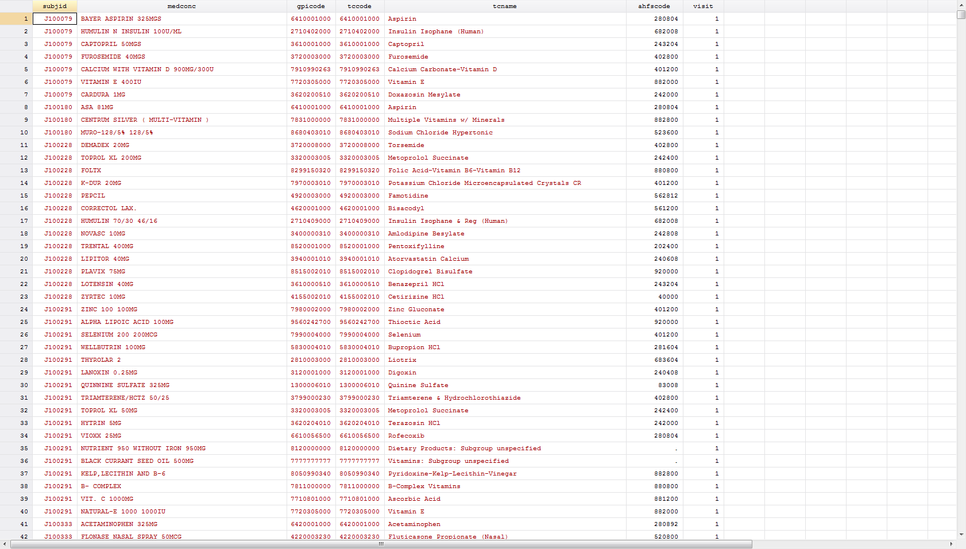
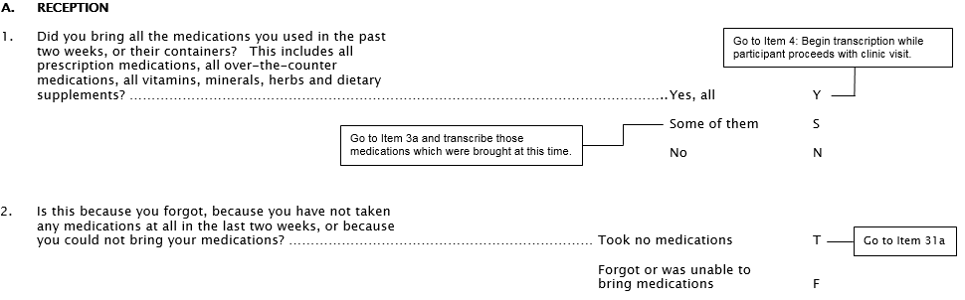
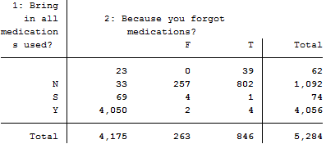
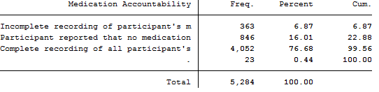
Medication (MEDCODES) Database
4,316 ptcpts. contributing 21,189 obs.
How to practically approach imputing these values?
Medication Survey Form (MSRa)
Use the first two questions from the medication survey to determine why participant did not appear in the medications database.
5,284 ptcpts. surveyed

Slide 2
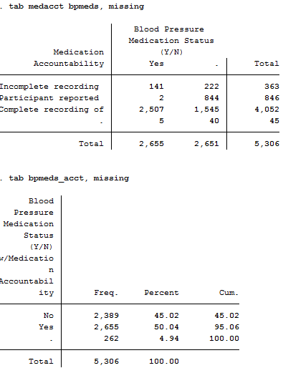
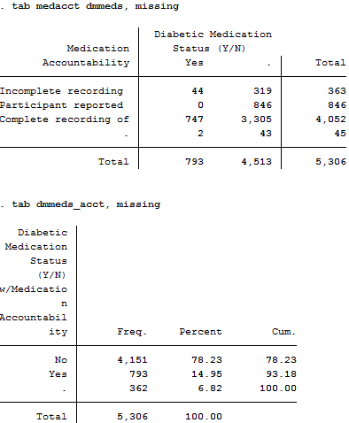
Meds Database + Self-Reported Accountability
Only update missing values

Slide 3
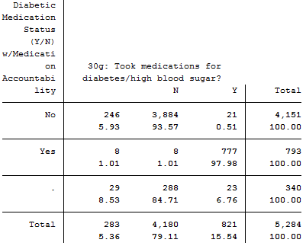
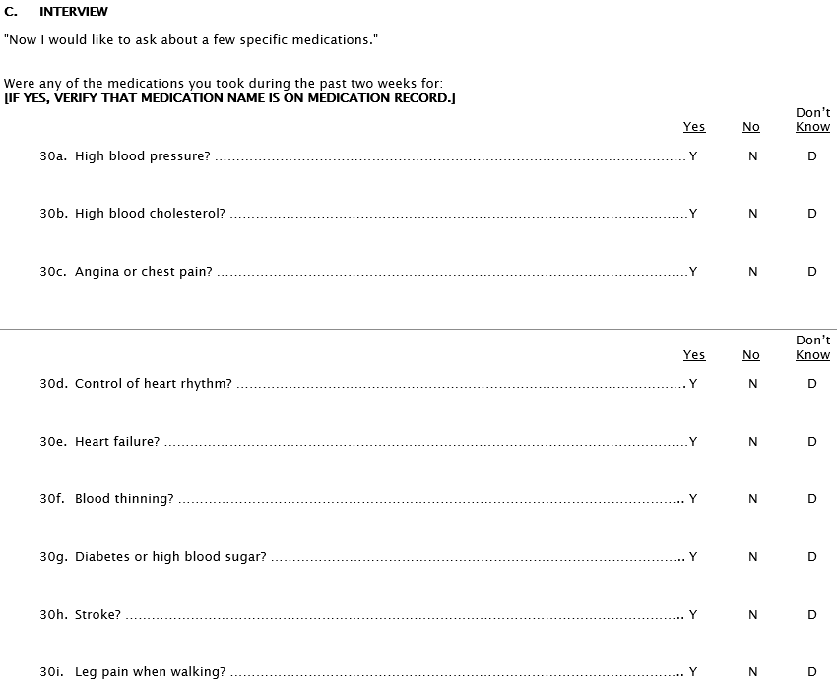
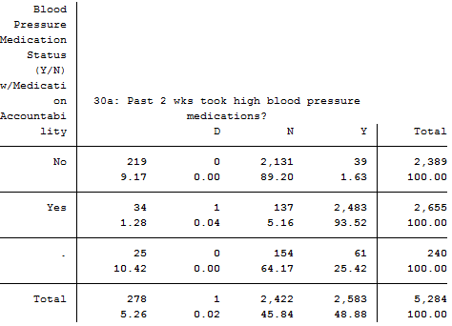
How do these compare to self-reports?
Use the medication-specific queries on the medication survey when our previous efforts are unsuccessful in classifying medication use.

Slide 4
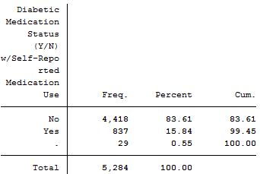
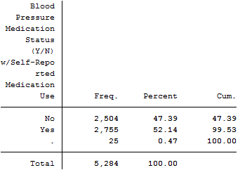
Meds Database + Self-Reported Accountability + Self-Reported Medication Use
Update discordant information
Update missing values

Slide 5
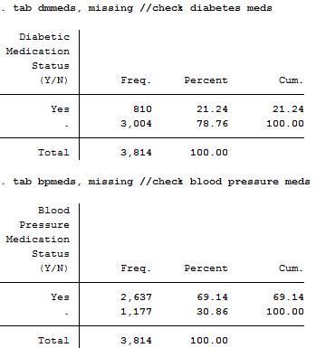
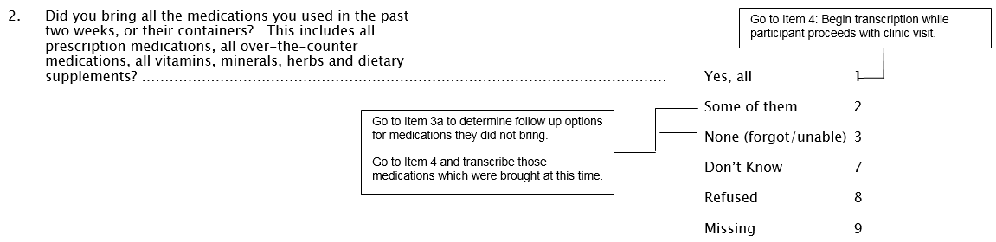
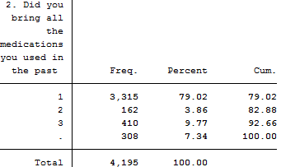
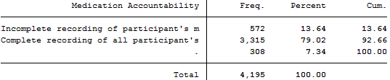
Medication (MEDCODES) Database
3,814 ptcpts. contributing 20,933 obs.
How to practically approach imputing these values?
Medication Survey Form (MSRb)
Use the first two questions from the medication survey to determine why participant did not appear in the medications database.
4,195 ptcpts. surveyed

Slide 6
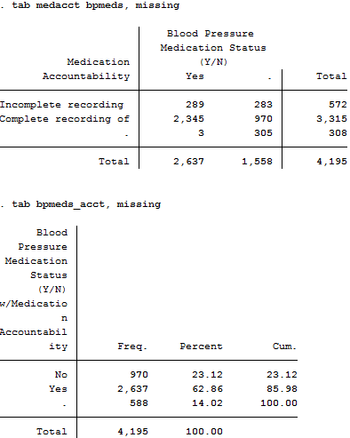
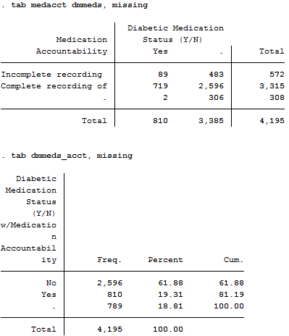
Meds Database + Self-Reported Accountability
Only update missing values

Slide 7
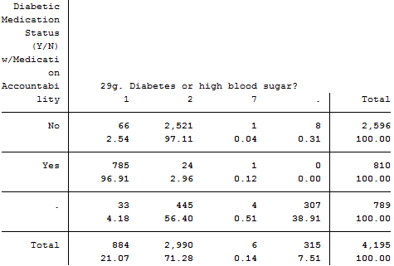
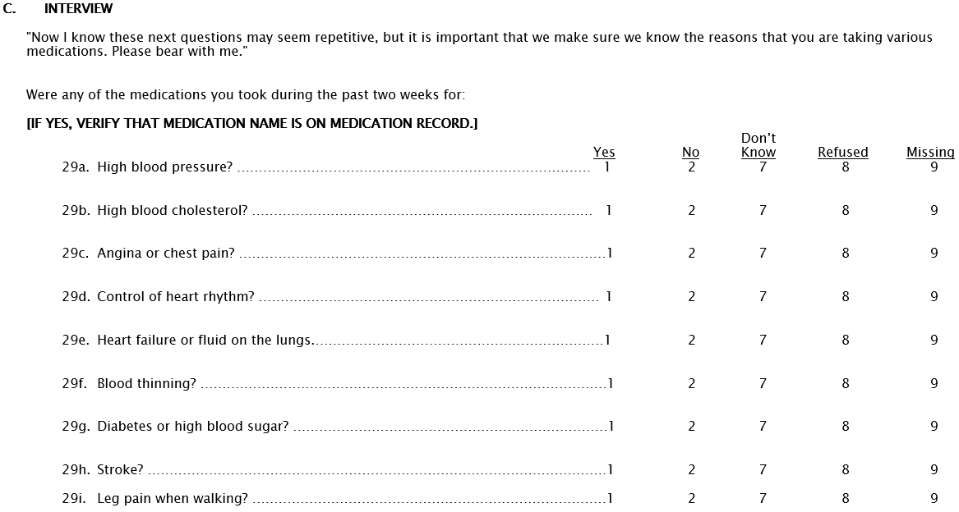
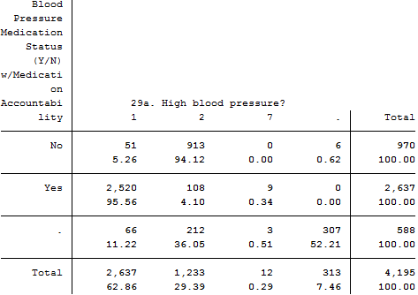
How do these compare to self-reports?
Use the medication-specific queries on the medication survey when our previous efforts are unsuccessful in classifying medication use.

Slide 8
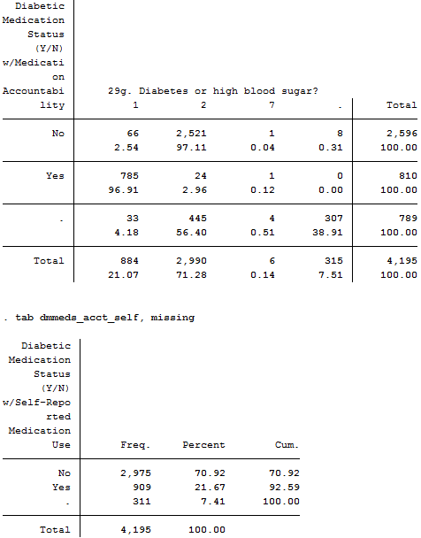
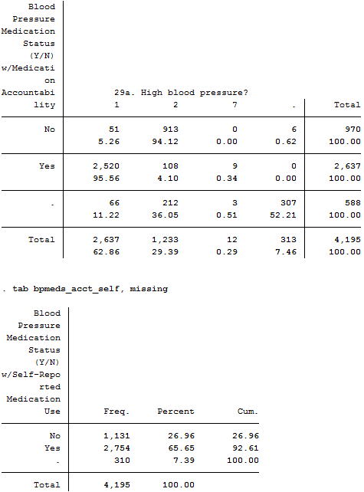
Meds Database + Self-Reported Accountability + Self-Reported Medication Use
Update discordant information
Update missing values

Slide 9
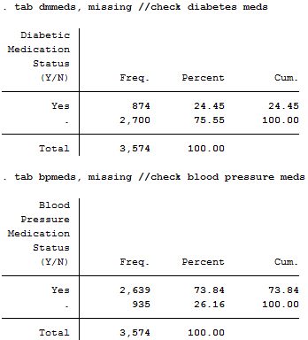
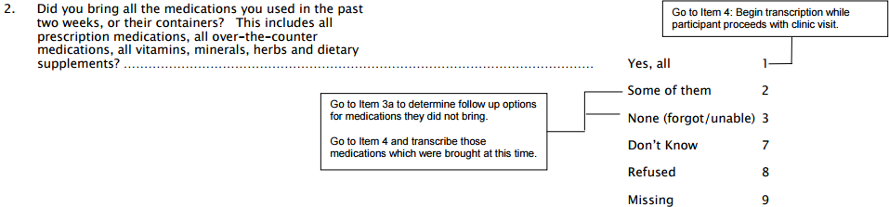
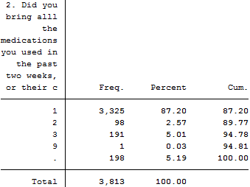
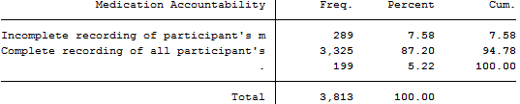
Medication (MEDCODES) Database
3,574 ptcpts. contributing 21,472 obs.
How to practically approach imputing these values?
Medication Survey Form (MSRc)
Use the first two questions from the medication survey to determine why participant did not appear in the medications database.
3,813 ptcpts. surveyed

Slide 10

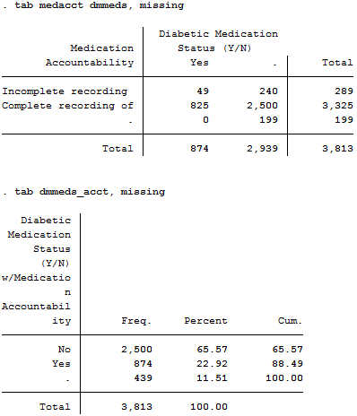
Meds Database + Self-Reported Accountability
Only update missing values

Slide 11
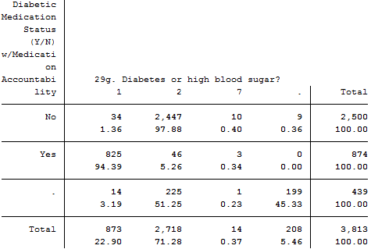
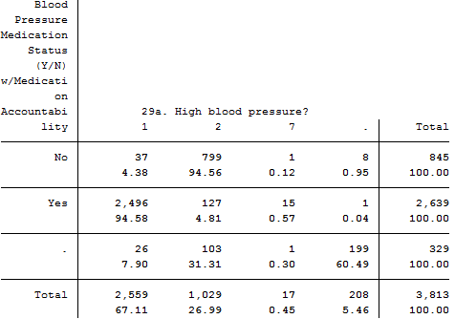
How do these compare to self-reports?
Use the medication-specific queries on the medication survey when our previous efforts are unsuccessful in classifying medication use.

Slide 12

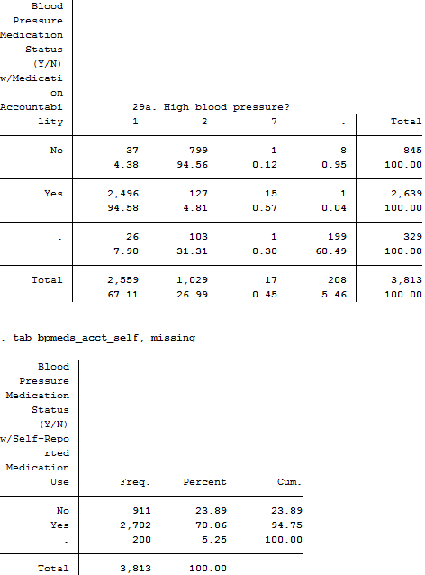
Meds Database + Self-Reported Accountability + Self-Reported Medication Use
Update discordant information
Update missing values

